Slide 1
Comparing Orange County, CA and Hennepin County, MN
Erick Campos

Slide 2
DISCLAIMER: this business report is for the final project for Coursera Course “Applied Data Science Capstone.” While the data compiled is real, the proposed business case is entirely fictitious. Any real-world resemblance to this report is purely coincidental. Any thoughts and opinions presented are my own.

Slide 3
Determining if Hennepin County is a potential host for a new Disney theme park
Hennepin, Minnesota was picked based on distance between Disneyland and Walt Disney World. Adding a property in Minnesota would more or less create a triangle of equal distance between the theme parks.
Stakeholders of interest would include The Walt Disney Company, as well as the residents of Hennepin.
Comparing Hennepin County to Orange County (Disneyland) could help determine if Hennepin would make sense as the next location of a Disney property.
Comparison will be made by mapping using k-means clustering based on the venues in the zip codes for each county.

Slide 4
Data Acquisition and Cleaning
Data source to extract zip codes for Orange County, CA: https://www.zipcodestogo.com/California/
Data source to extract zip codes for Hennepin County, MN: https://www.zipcodestogo.com/Minnesota/
Latitude and Longitude data for zip codes come from a function that calls upon the ArcGIS mapping API.
Data source for venues of interest come from Foursquare API.
Tables were created and joined from data sources, any NaN values were removed to avoid errors.

Slide 5
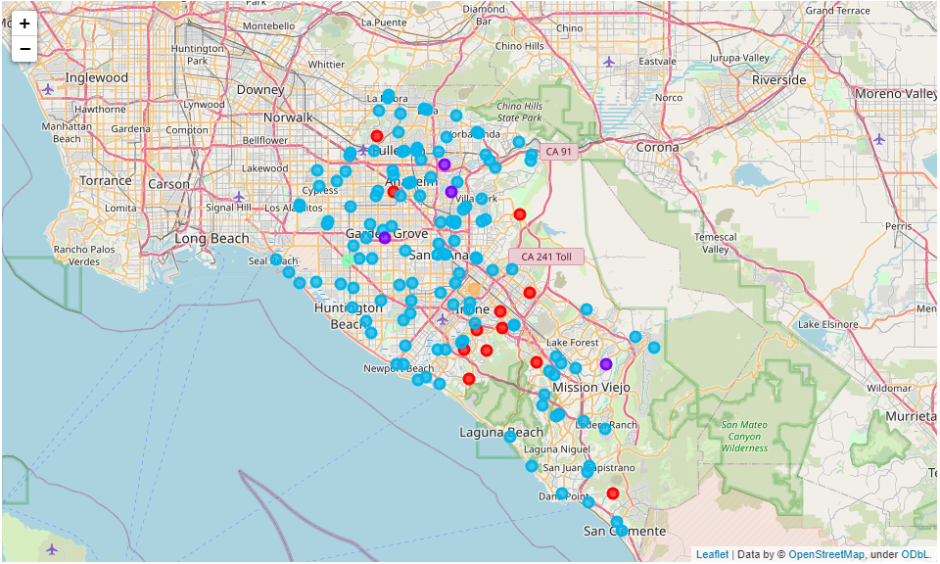
Visual Mapping of Orange County, CA

Slide 6
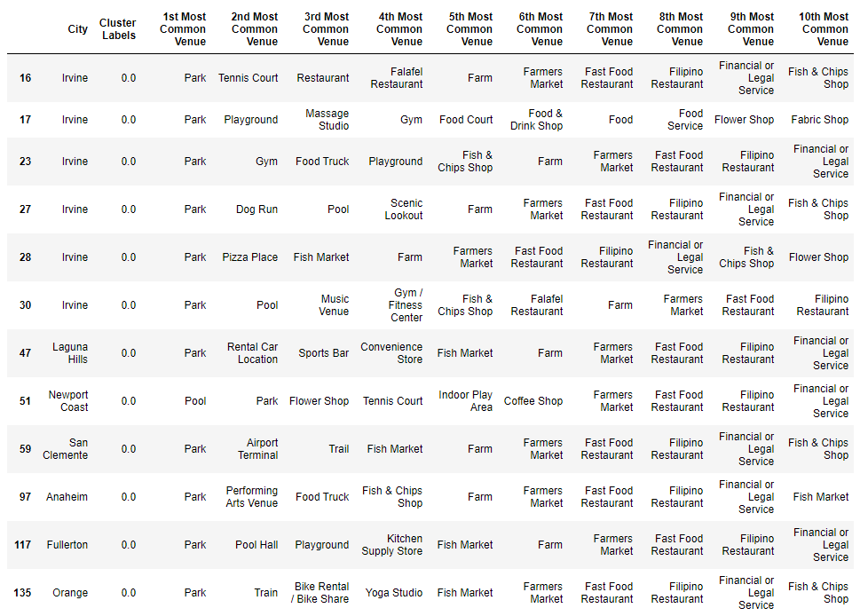
Orange County, Cluster 1 (Red)
This cluster can be labeled as recreational areas, since they mostly include parks, pools, playgrounds, and other outdoor activities.

Slide 7
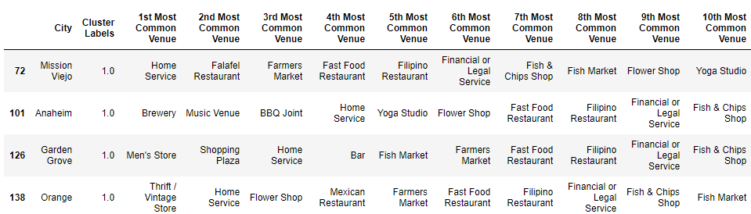
Orange County, Cluster 2 (Purple)
This area also comprises of recreational areas, but not outdoor recreation.
More indoor venues and restaurants for fun nights out.

Slide 8
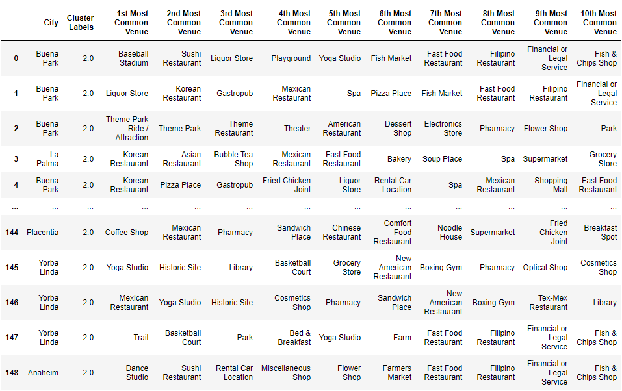
Orange County, Cluster 3 (Blue)
These zip codes are the surrounding areas of theme parks, including the Disneyland Resort and Knott’s Berry Farm.
Home to a large variety of cultures, which is why there are so many different restaurants, including Mexican, Korean, Filipino, and Vietnamese.
Most important cluster, as it looks like this is the cluster that has built itself around the theme park and entertainment industry.

Slide 9
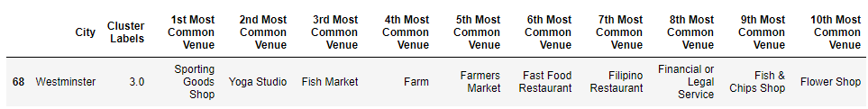
Orange County, Cluster 4 (Green)
It only includes one zip code. I am going to consider this an outlier, as it includes a venue that the other clusters did not have: a farm.

Slide 10
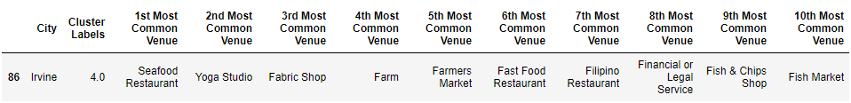
Orange County, Cluster 5 (Yellow)
This cluster is also only one data point. I will also consider it an outlier because of the “farm” data point.

Slide 11
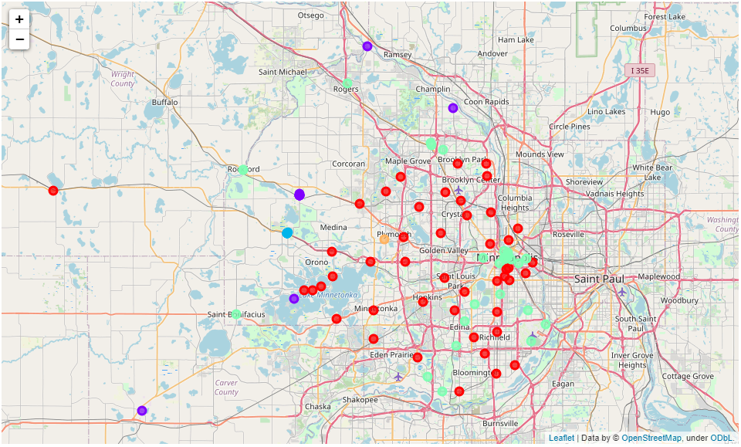
Visual Mapping of Hennepin County, MN

Slide 12
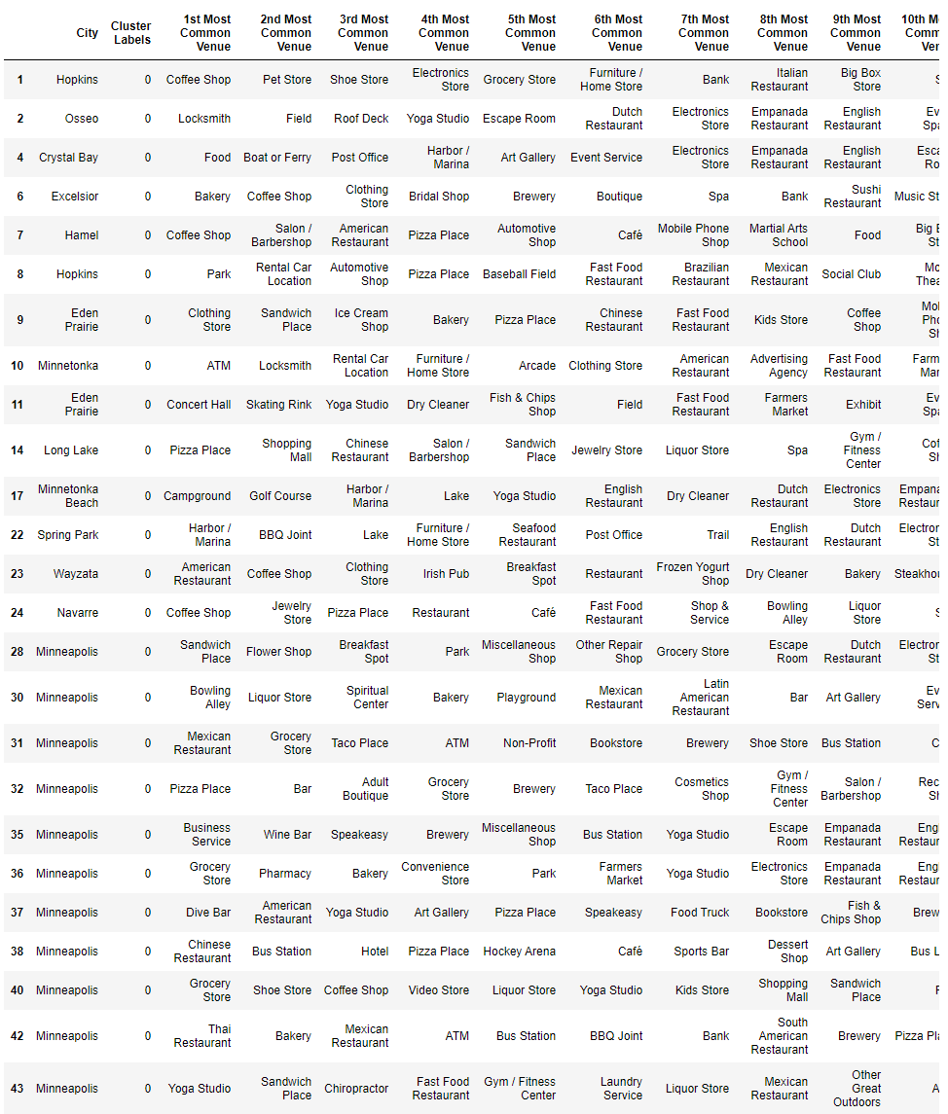
Hennepin County, Cluster 1 (Red)
The full data set is not displayed here, but this cluster looks like it captured some of Minneapolis and its surrounding areas.
There seems to be a large variety of venues in this cluster alone, mostly restaurants and the like.
These can be considered recreational areas that do not include outdoor activities, as we saw in one of the Orange County clusters.

Slide 13
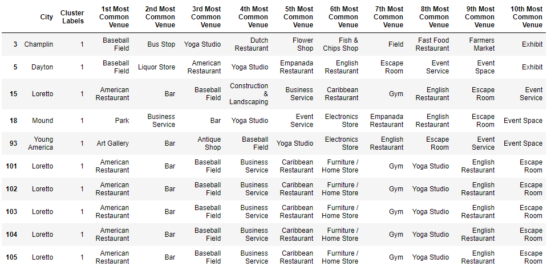
Hennepin County, Cluster 2 (Purple)
Many data points are repeated. This could be because many different zip codes are attributed to one city, and perhaps these particular cities are not very large.
This can be the “baseball” cluster, as it looks like it revolves around the baseball field venue.

Slide 14
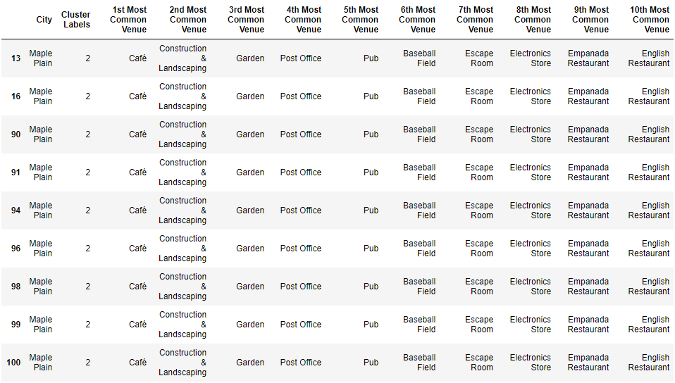
Hennepin County, Cluster 3 (Blue)
Although this cluster technically has many different data points, they all point to the same things. Again, this could be attributed to several zip codes corresponding to one city, and that city not being particularly large.
I will have to label this cluster as an outlier, as it only really attributes to one “unique” row.

Slide 15
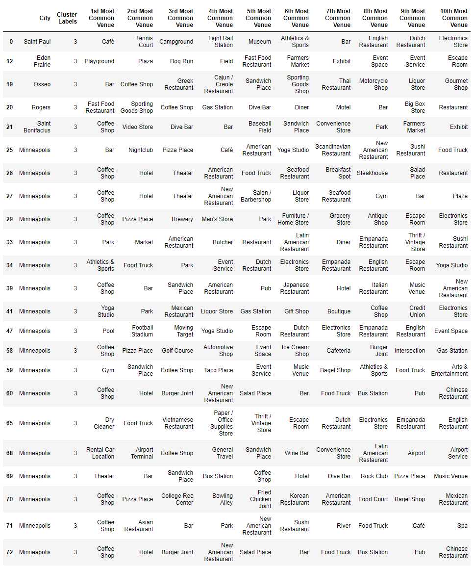
Hennepin County, Cluster 4 (Green)
This cluster can be labeled as the heart of Minneapolis. Many of these data points are placed in the center of Minneapolis and include a large variety of restaurants, eateries, and other fun things to do.

Slide 16
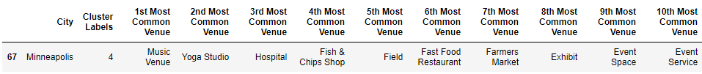
Hennepin County, Cluster 5 (Yellow)
This cluster only contains one unique row so I will have to label it as an outlier.

Slide 17
Conclusions
Orange County and Hennepin County share more similarities than I had first assumed, based on the two large clusters for each of the corresponding counties. The city of Minneapolis seems to share similar venues as the city of Anaheim, which would make it seem like a good candidate for a Disney theme park. However, one most keep in mind that only 2 out of the 5 clusters for each county seemed to share similar attributes. Each county had 2 outliers that were not very similar. One must also consider the fact that Anaheim and its surrounding areas were in a way built around Disneyland. Minneapolis and its surrounding areas have all of those fun venues, restaurants, and eateries without the presence of a large theme park.
Ultimately my recommendation to proceed with Hennepin County as a host for a Disney theme park would be… to investigate Hennepin County further. There are many other factors that should be considered that are not captured in this initial set of data, which are discussed in the following section.

Slide 18
Future Directions
In the future, the first think I would recommend is to cluster the data differently. I aimed to keep things consistent by using a k-means factor of 5 for both counties, but it might be useful to find the optimal k-means factor for both counties, even if it means sacrificing some of the consistency (for example, if Orange County would be better clustered by a factor of 7 and Hennepin County by a factor of 3).
Something to keep in mind about this data is that it is coming from the Foursquare API, which for the most part is “crowdsourced,” meaning that it depends heavily on user input. The data could be biased because people would be more inclined to report or “check-in” at restaurants and other fun things to do versus other buildings and venues such as hospital, churches, and government buildings.
I think that the people living in those areas are an important factor in making this decision, and this initial dataset does not capture very much of who is living there. Assumptions can be made, but it would be helpful to know things such as income and age of the individuals there. It would paint a much clearer picture as to who is living in those cities and who is going to those venues.

